Slide 1

CB East Marching Patriots
Pumpkin Painting Fund Raiser
CB East
MARCHING PATRIOTS
Sunday, September 16, 2018
Peddler’s Village
(in the open field behind Earls)

Slide 2
We Need Volunteers
Both band members and parents
Volunteers will help set up,
break down, distribute supplies,
help children painting, clean brushes
Have Fun!

Slide 3
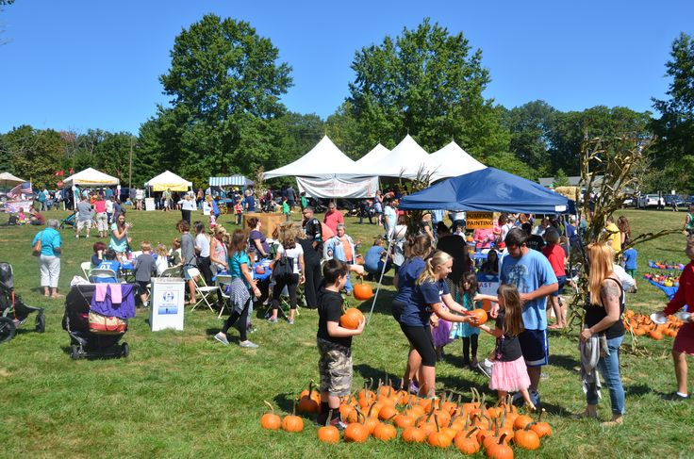
Last Year We Raised $!500 For the Band!

Slide 4
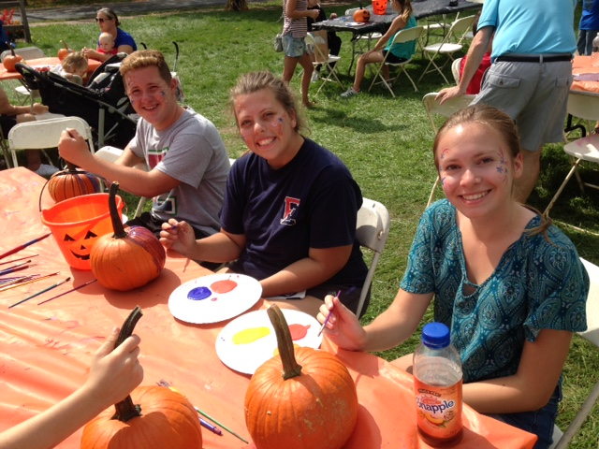

Slide 5
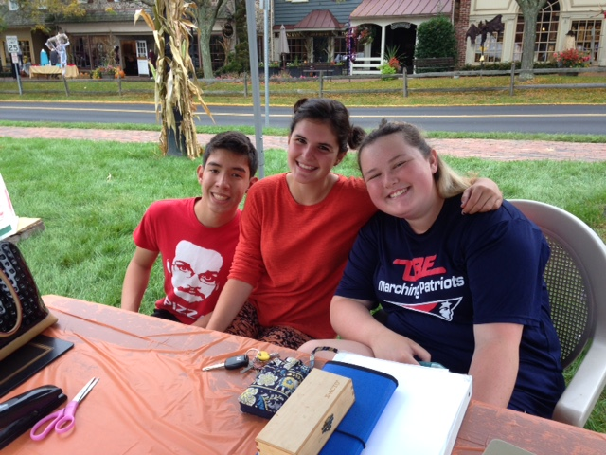

Slide 6
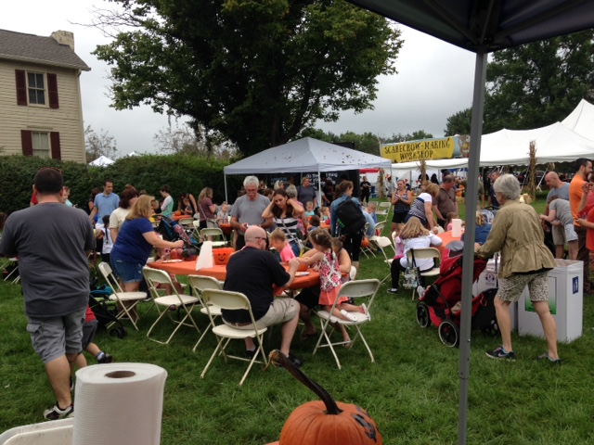

Slide 7
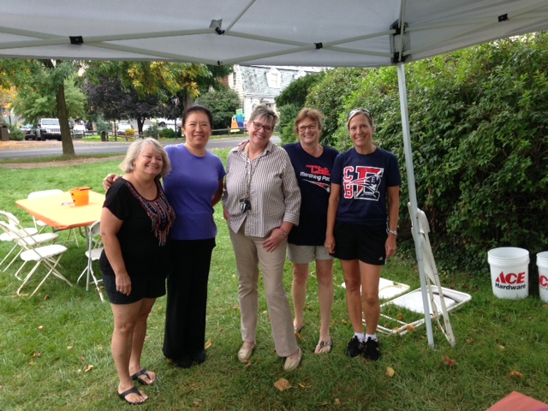

Slide 8
